Slide 1

IT 334 – DevOps Engineering on AWS Cloud
Project – Building a Highly Available, Scalable Web Application
Group X: Ejub Šabić
Kerim Ahmedspahić Amar Fazlić
Date:
11. June 2023
Teacher: Dzenana Dzevlan

Slide 2
Business scenario overview
Provide problem or opportunity statement.
Describe solution requirements.
Refer to the slide notes for more information.
Notes:
You can also go more in depth about the design considerations and trade-offs that you made.

Slide 3
Solution overview
Provide a high-level description.
Explain design considerations.
Explain use cases.
Refer to the slide notes for more information.
Notes:
Explain at a high level what you have built.
For example: “I built a web application for a company to host their blog.“
Talk about why you chose certain parts of the solutions and any tradeoffs that you made. Focus on how you designed the solutions and how you applied the AWS Well-Architected Framework as part of the process (AWS Well-Architected Framework: https://docs.aws.amazon.com/wellarchitected/latest/framework/welcome.html).
For example: “I configured load balancers and auto scaling to make the application highly available and reliable.”
Include the use cases that you are addressing. Think about who your users are and how they would want to interact with your solution to solve their problem.
For example: “Users can view, upload, edit, and delete blog posts. Administrators can approve blog posts.”
Talk about the use cases that you addressed as part of the minimum viable product (MVP) that you scoped and built.
Note:
An above-bar description is concise and includes the most important benefits. For example: “The solution allows customers to quickly upload, store, and search large catalogs of images and videos in Amazon S3.”
A below-bar description is too detailed or not specific. For example: “Our solution analyzes media files.”

Slide 4
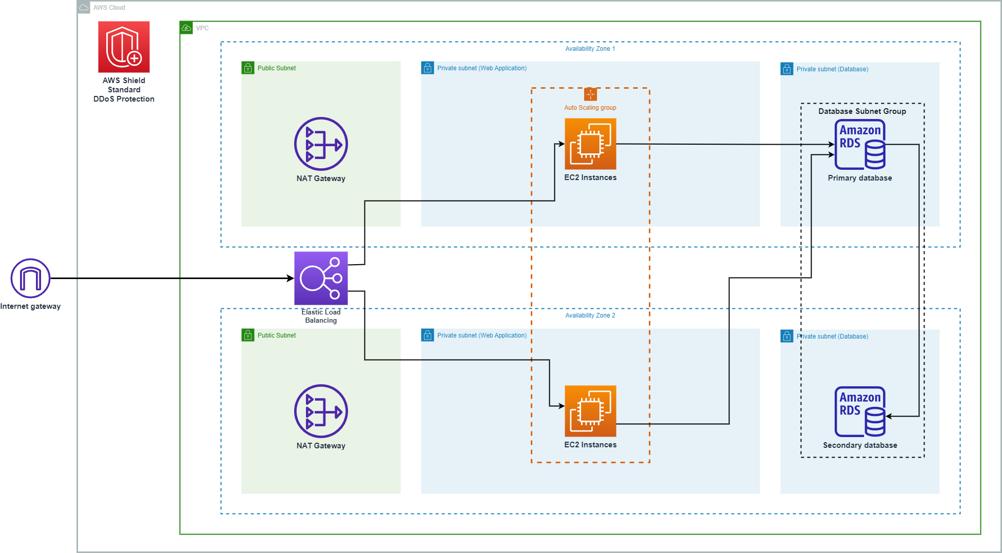
Architecture diagram of the planned solution
Reference: https://docs.aws.amazon.com/whitepapers/latest/web-application-hosting-best-practices/an-aws-cloud-architecture-for-web-hosting.html

Slide 5
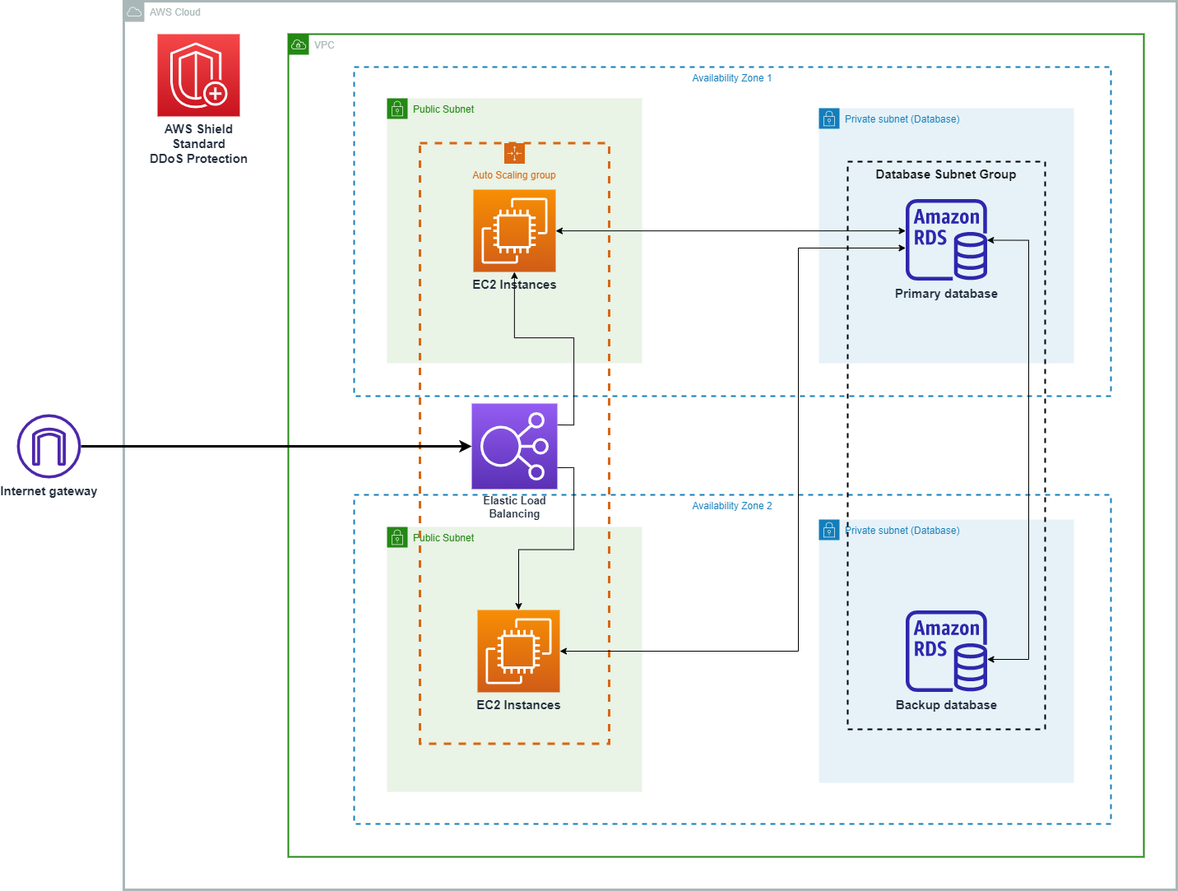
Architecture diagram of the final solution

Slide 6
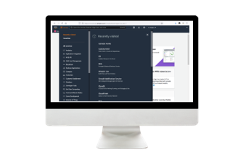
Demo
http://alb-group12-1087131232.us-east-1.elb.amazonaws.com/students
Notes:
For the demo, guide the audience through the two to three most important benefits of the solution and how it addresses the requirements.
Your demo materials can be screen captures, recordings, or to show AWS console.

Slide 7
Lessons learned
Describe any challenges that you overcame.
List resources that you found helpful.
Describe any new skills that you used.
Explain next steps.
Refer to the slide notes for more information.​
Notes:
Describe any challenges that you encountered and how you overcame those challenges.
For example: “I got stuck when I was creating an EC2 instance to host the application. I used the resources that were listed in the instructions to walk myself through the process to create a new EC2, and I was able to complete the task. The links to labs in other courses were very helpful.”
Describe any new skills that you learned from this project.
For example: “I learned how to set up auto scaling correctly so my resources were automatically adjusted and allocated at the lowest possible cost.”
Discuss any future, out-of-scope use cases in the next steps.
For example: “I would like to scale out the web application so that multiple departments can use it.”

Slide 8

Demo
Notes:
Describe any challenges that you encountered and how you overcame those challenges.
For example: “I got stuck when I was creating an EC2 instance to host the application. I used the resources that were listed in the instructions to walk myself through the process to create a new EC2, and I was able to complete the task. The links to labs in other courses were very helpful.”
Describe any new skills that you learned from this project.
For example: “I learned how to set up auto scaling correctly so my resources were automatically adjusted and allocated at the lowest possible cost.”
Discuss any future, out-of-scope use cases in the next steps.
For example: “I would like to scale out the web application so that multiple departments can use it.”

Slide 9

Questions?

Slide 10
THANK YOU!

